Slide 1
Logistic Regression 2 – Iris Case and Softmax
Michael Claudius, Associate Professor, Roskilde

Slide 2
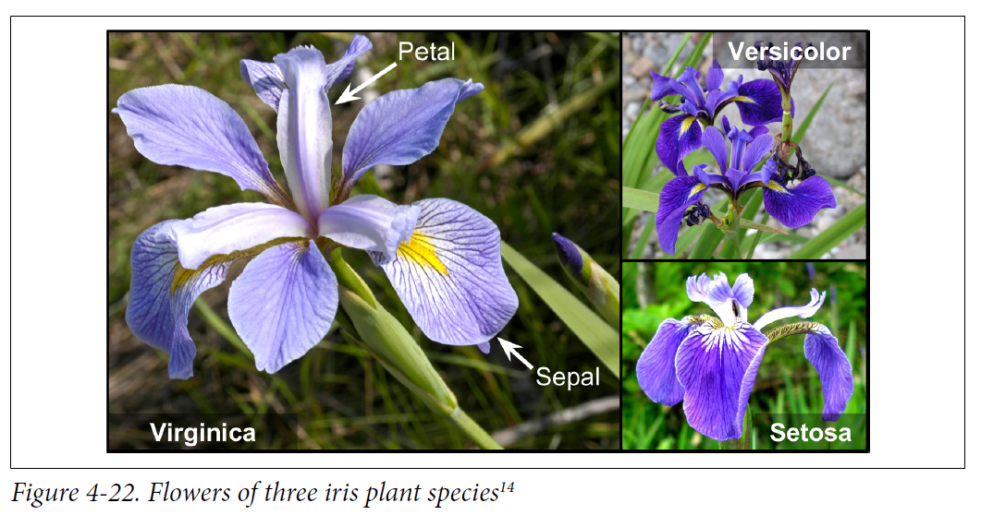
The Iris flower case
Data set with 150 Iris pictures of 3 different species (50 each)

Slide 3
Choose and build classifier(s)
Find features and make a decision. Remember simple ones first!
First, a binary classification based on
Petal width, Iris Virginica or Not Iris Virginica
Petal width and length, decision boundaries Virginica or Not Iris Virginica
Second, Multinomial classifier based on
Petal width and length, Iris Virginica OR Iris Versicolor OR Iris Setosa
Using Softmax
Third, binary classification based on
Sepal width, Iris Virginica or Not Iris Virginica
Sepal width and length, decision boundaries Iris Virginica or Not Iris Virginica
Fourth, Multinomial classifier based on
1. Petal width and length , Sepal width and length, Iris Virginica OR Iris Versicolor OR Iris Setosa

Slide 4
Classifier code using Sklearn on Iris data set
Highlights of code
More is given in the LogisticRegIris.ipynb program on teacher’s home page
Import data set from sklearn import datasets iris = datasets.load_iris() list(iris.keys()) X = iris["data"][:, 3:] # petal width y = (iris["target"] == 2).astype(np.int) # 1 if Iris virginica, else 0
Train regression model from sklearn.linear_model import LogisticRegression log_reg = LogisticRegression(solver="lbfgs", random_state=42) log_reg.fit(X, y)
Plot probability and decision boundary A lot of hokus pokus. Next slide

Slide 5
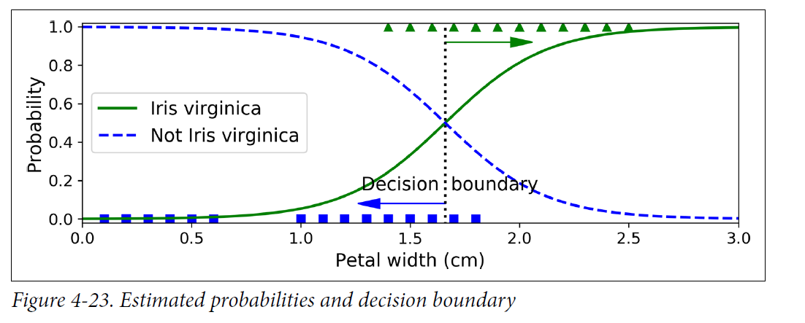
Iris: Probability plot with a decision boundary
Probability function using petal width

Slide 6
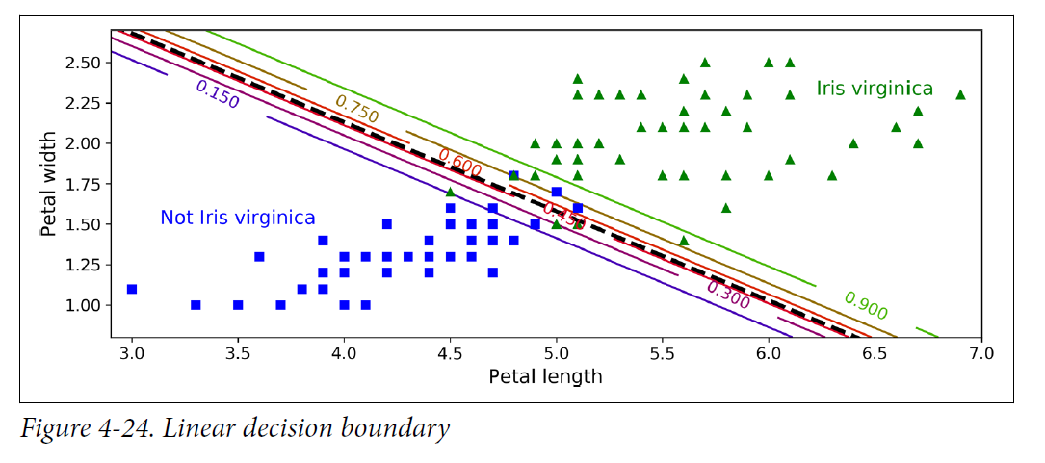
Iris: Probability plot with decision boundaries
Probability function using petal length and petal width
Notice the linear decision boundaries (e.g. green 90%probability)
What if I want more than two classes? No problem use Softmax regression

Slide 7
Classifier using Softmax Regression
Softmax is a multinomial logistic regression classifier
Support 2 or more classes; multiple classes
Predict one class at a time
Estimate probability for each class given an instance X
Classes must exclude each other!

Slide 8
Softmax Regression Steps
Compute a score (Softmax score) for every class for instance x
Estimate the probability for each class using normalized exponential (softmax function)
Predict the class with highest probability
Train the model so high probability for the target classes
Minimizing the cross cost entropy function
All done by applying Batch Gradient Descent
All in all, similar steps as linear regression as well as logistic regression for binary class
BUT more complicated mathematical formulas and functions

Slide 9
Softmax functions
This I will skip ☺☺ I don’t want to be killed by students

Slide 10
Classifier code using Softmax on Iris data set
Highlights of code
More is given in the LogisticRegIris.ipynb program on teacher’s home page
Import data set from sklearn import datasets iris = datasets.load_iris() list(iris.keys()) X = iris["data"][:, (2,3)] # petal length , petal width y = iris["target"] #all 3 classes involved
Train regression model from sklearn.linear_model import LogisticRegression soft_reg = LogisticRegression(class=“multinomial, ”solver="lbfgs", C=10) soft_reg.fit(X, y)
soft_reg.predict([5,2]) array([[1.55606703e-04, 9.51675722e-01, 4.81686717e-02]])
Plot probability and decision boundaries A lot of hokus pokus. Next slide

Slide 11
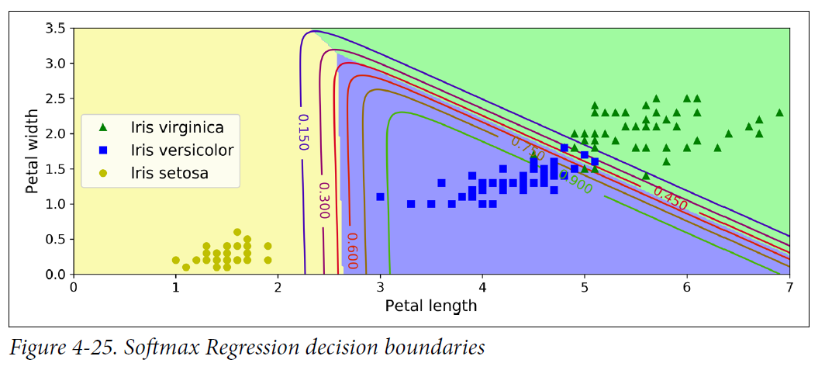
Iris: Probability plot with decision boundaries
Probability function using petal length and petal width and 3 classes
Notice the linear decision boundaries (e.g. green 90%probability) for Iris Versicolor

Slide 12
The Program Code
It is time for a short review of the code
I will highlight a few points
Logistic Regression Iris Program

Slide 13
Exercise
It is time for discussion, coding and solving the Iris case yourself
Logistic Regression Iris Exercise Logistic Regression Iris Program
Or if you need rest an old timer: Donald Duck on Math hunting 1959

